Slide 1
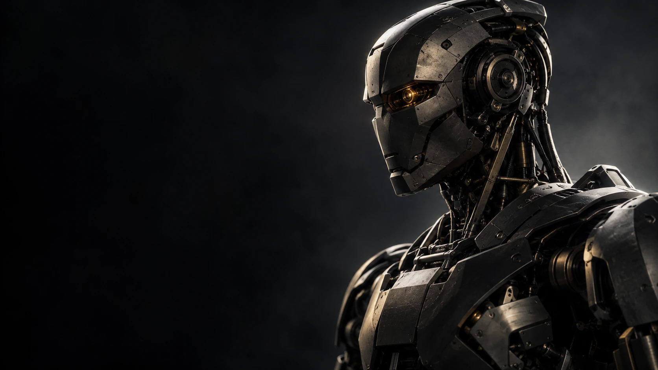
ROBOTICS CAPITAL
SWITZERLAND ROBOTICS FUND 1
01
EUROPE’S FUTURE
DESERVES TO BE
BUILT HERE
Switzerland has the builders.
We back them before the first round.
CHF 10M
FORMATION / PRE-SEED
TARGET FIRST CLOSE Q4 2026
Notes:
PRESENTER SCRIPT
There are moments when a region has to decide whether it will help build the next industry or mainly buy what others build. We believe physical AI is one of those moments. Switzerland has the research, the engineering culture and an extraordinary generation of young builders. We started Robotics Capital because we work close to those people, and we want more of them to become founders. Our ambition is straightforward: give promising robotics teams their first serious backing, help them build companies here, and give our investors a meaningful stake in what they create.
SOURCES
Fund facts supplied by Robotics Capital AG. Website artwork and brand: https://roboticscapital.ch. European competitiveness context: https://commission.europa.eu/topics/competitiveness/draghi-report_en.
INVESTMENT CONTEXT
The cover expresses the manager’s investment thesis and ambition. It does not assert a deadline after which European innovation becomes impossible. Conceptual artwork is not a portfolio product. Indicative; final terms subject to counsel, LPA, tax and regulatory review.

Slide 2
ROBOTICS CAPITAL
MARKET SIZE / CAPITAL FORMATION
02
The market is large.
The investment cycle is early.
$88.3B
$27.6B
$5T
2026 robotics market estimate
2025 robotics & physical AI VC
2050 humanoid market scenario
$259.1B forecast for 2032
19.62% CAGR, 2027–2032
1,009 deals
About 2× the 2024 funding total
Includes the supply chain,
maintenance and support
Mordor Intelligence / Oct 2026
PitchBook, via Foley / Sep 2026
Morgan Stanley / May 2025
Market estimates, venture financing and a long-term scenario have different scopes and are not additive. Forecasts are not fund returns. Sources and definitions in notes.
Notes:
Mordor estimates the global robotics market at $88.27 billion in 2026 and forecasts $259.1 billion by 2032. PitchBook data, as reported by Foley, puts 2025 robotics and physical AI venture funding at $27.6 billion across 1,009 deals, about twice the $13.7 billion reported for 2024. Morgan Stanley’s longer-term humanoid scenario reaches $5 trillion by 2050, including the supporting supply chain and services. Our investment case connects this demand to early ownership in teams building commercially useful technology.
The market forecast, annual VC financing and 2050 scenario measure different things and must not be summed. Mordor’s current edition updates the screenshot’s 2031 forecast to 2032. Its 19.62% CAGR applies to 2027–2032. Funding growth is about 101%, not 270%. The PitchBook figures were corroborated through Foley; the primary report could not be accessed. Morgan Stanley expects humanoid adoption to accelerate in the late 2030s. This is context for the thesis, not a forecast of CHRF1 performance.
Mordor market estimates: https://www.mordorintelligence.com/industry-reports/robotics-market
Funding figures and underlying report citation: https://www.foley.com/insights/publications/2026/09/can-patent-filings-help-physical-ai-companies-raise-capital/
Morgan Stanley humanoid scenario: https://www.morganstanley.com/insights/articles/humanoid-robot-market-5-trillion-by-2050

Slide 3
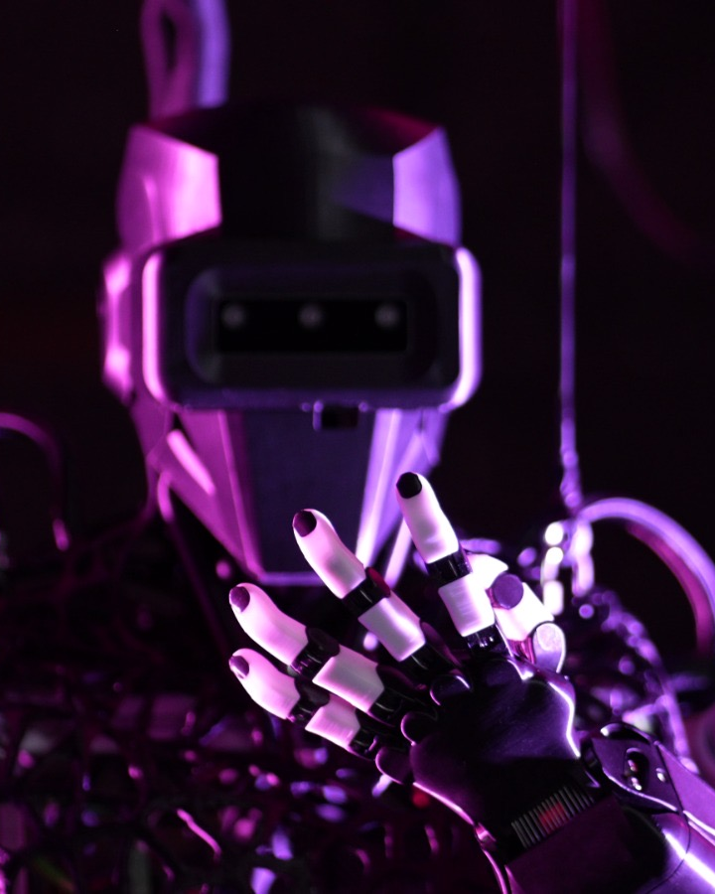
ROBOTICS CAPITAL
SWITZERLAND ROBOTICS FUND 1
03
Robotics has reached
real commercial scale
5M
~250K
Industrial robots operating
worldwide at year-end 2025
Professional service robots
shipped worldwide in 2025
+11%
Industrial robot installations
growth in 2025
+24%
Service robot shipments
growth in 2025
Sources: IFR, World Robotics 2026 releases, 24 and 30 September 2026. Global 2025 data. Installed stock and annual shipments are different measures.
Notes:
PRESENTER SCRIPT
Robotics already operates at commercial scale. At the end of 2025, factories used five million industrial robots, while annual professional service robot shipments were nearly 250,000. Industrial installations grew 11% and professional service shipments grew 24% in 2025. These are observed deployment measures, not a speculative addressable-market estimate. Our investment inference is that growing deployment can create demand for the systems, intelligence and components that make robots useful. Each company must still prove a customer need and credible economics.
SOURCES
IFR World Robotics 2026 industrial release, 24 September 2026: https://ifr.org/ifr-press-releases/news/five-million-robots-now-operate-in-factories-globally
IFR World Robotics 2026 service release, 30 September 2026: https://ifr.org/ifr-press-releases/news/global-sales-of-professional-service-robots-surge-24-percent
DEFINITIONS AND LIMITS
5M is an installed stock at year-end; approximately 250K is annual shipments. The 11% figure measures industrial installations, not growth in the stock; the 24% figure measures professional service robot shipments. These global markets extend well beyond humanoids. Industry adoption is not proof of a CHRF1 portfolio company's product-market fit, returns or investment access. Humanoid commercial use remains early and faces technical and economic constraints.

Slide 4
ROBOTICS CAPITAL
WHY SWITZERLAND
04
Why Switzerland
A proven engine for company creation
661
CHF 540M
79
ETH Ventures through 2025
Raised by ETH Ventures in 2025
Acquired or merged
46 new ventures created in 2025
41 financing rounds
93% spin-off survival at five years¹
In Swiss deep tech, local capital’s share falls as rounds grow
$0–15M ROUNDS | $15–100M ROUNDS | >$100M ROUNDS
36% | 18% | 12%
Our entry point: ownership at formation, before the larger financing rounds.
Sources: ETH Ventures Report 2025; ¹ ETH Spin-off Report 2024. Swiss Deep Tech Report 2026, p.16 (2024–2026 funding). ETH totals cover all sectors; capital share is not equity ownership.
Notes:
Switzerland offers an established route from research to company creation. ETH recognised 661 ventures through 2025, including 46 new ventures that year. ETH Ventures raised CHF 540 million across 41 financing rounds in 2025. The ecosystem has also produced 79 acquisitions or mergers. Its 2024 report recorded 93% survival five years after founding. Commercial examples include Wingtra’s reach across more than 1,500 organisations and Verity’s deployment of over 250 drones at 73 IKEA locations. Swiss investors provide a smaller share of funding as rounds grow: 36% in rounds below $15 million, 18% in $15–100 million rounds, and 12% above $100 million. Our strategy is to build an ownership position at formation and help founders prepare for the capital and customers that enable them to scale.
The 661 ventures and 79 acquisitions or mergers are cumulative through 2025. The 46 new ventures, CHF 540 million and 41 financing rounds refer to 2025. These ETH figures cover all sectors. The 93% measure is five-year survival reported in 2024, not the share of all historical ventures active today. Swiss funding shares measure the origin of invested capital, not ownership or company relocation. These are ecosystem examples, not CHRF1 performance or guaranteed deal flow.
ETH Ventures Report 2025, pp. 6, 7, 12, 16 and 18. ETH Spin-off Report 2024, editorial. Swiss Deep Tech Report 2026, p. 16: funding period 2024–2026, data as of 29 May 2026. Wingtra website, accessed 27 October 2026. Ingka Group, 16 August 2024.
ETH Ventures Report 2025: https://ethz.ch/content/dam/ethz/associates/entrepreneurship-dam/documents/ETH_Ventures_Report_2025.pdf
ETH Spin-off Report 2024: https://ethz.ch/content/dam/ethz/main/industry/entrepreneurship/ETH-spin-offs/dokumente/ETH%20Spin-off%20Report%202024.pdf
Wingtra commercial reach: https://wingtra.com/
IKEA / Verity deployment: https://www.ingka.com/newsroom/ikea-is-elevating-human-ai-powered-drone-collaboration/?trk=article-ssr-frontend-pulse_little-text-block

Slide 5
ROBOTICS CAPITAL
CAPITAL FORMATION / STRATEGIC EXITS
05
2026 highlights
Gravis Robotics
TAR
RIVR Robotics
$200M
$120M
Amazon
Series A from SoftBank
Series A led by Spark Capital
Acquisition
$1B valuation¹
Off-grid power for AI data centres
Autonomous doorstep delivery
SELECTED ETH ACQUISITIONS
COMPANY / TECHNOLOGY | ACQUIRER
Sevensense Navigation for mobile robots | ABB
FemtoTools Precision micro- and nano-instruments | Oxford Instruments
Seervision AI camera automation | Q-SYS / QSC
Animatico Interactive AI avatars | NVIDIA
COMPANY / TECHNOLOGY | ACQUIRER
Dacuda 3D division Computer vision and 3D scanning | Magic Leap
Skybotix Visual-inertial drone navigation | GoPro
Koubachi Connected plant sensors | Husqvarna
Kooaba Mobile image recognition | Qualcomm
¹ Gravis valuation: ETH Zurich citing Inc. Financing and acquisition examples, not Robotics Capital portfolio results. TAR is an AI energy infrastructure company. Sources in notes.
Notes:
Gravis Robotics raised $200 million in a Series A from SoftBank at a $1 billion valuation. TAR announced a $120 million Series A led by Spark Capital to expand off-grid power systems for AI data centres, combining generation, storage and controls. Amazon acquired RIVR Robotics, adding autonomous doorstep-delivery technology. The acquisitions below show the broader strategic-buyer history of the ETH ecosystem, including ABB, Oxford Instruments, Q-SYS, NVIDIA, Magic Leap, GoPro, Husqvarna and Qualcomm.
Gravis and TAR figures are US dollars and describe financing rounds, not exits. Gravis’s $1 billion post-money valuation is reported by Inc. and cited by ETH Zurich. TAR is a US-based AI power-infrastructure company, presented as a broader physical-technology example, not as an ETH spin-off. RIVR’s acquisition price was not disclosed. The lower tables contain selected ETH ecosystem acquisitions. Dacuda refers only to its 3D division. These examples do not imply Robotics Capital ownership, investment returns or exclusive access.
Gravis Robotics, 17 August 2026. ETH Zurich, 18 August 2026, citing Inc. for the valuation. Cleary Gottlieb, 4 September 2026, confirms completion of SoftBank’s investment. TAR company website and September 2026 financing announcement. ETH Zurich and acquirer announcements for the acquisition history.
Gravis $200M Series A announcement: https://www.gravisrobotics.com/series-a
SoftBank transaction completion: https://www.clearygottlieb.com/news-and-insights/news-listing/softbank-completes-series-a-investment-in-gravis-robotics
Gravis $1B valuation / ETH Zurich: https://ethz.ch/en/news-and-events/eth-news/news/2026/08/200-million-for-autonomous-excavators.html
TAR $120M Series A / company announcement: https://www.tar.com/
RIVR / Amazon: https://ethz.ch/en/news-and-events/eth-news/eth-zurich-in-the-media/in-the-media-2026/in-the-media-january---april-2026.html
Sevensense / ABB: https://new.abb.com/news/detail/111398/abb-acquires-sevensense-expanding-leadership-in-next-generation-ai-enabled-mobile-robotics
FemtoTools / Oxford Instruments: https://www.oxinst.com/news/acquisition-of-femtotools-ag-now-complete/?sbms=raman
Seervision / Q-SYS: https://www.qsys.com/resources/news/detail/q-sys-completes-acquisition-of-seervision/
Animatico / NVIDIA: https://inf.ethz.ch/news-and-events/spotlights/infk-news-channel/2023/02/roveri-interview.html
Dacuda 3D division / Magic Leap: https://entrepreneurship.ethz.ch/startup-stories/explore-startup-portraits-and-success-stories/spinoff/exits/dacuda.html
Skybotix / GoPro: https://entrepreneurship.ethz.ch/startup-stories/explore-startup-portraits-and-success-stories/spinoff/exits/skybotix.html
Koubachi / Husqvarna: https://entrepreneurship.ethz.ch/startup-stories/explore-startup-portraits-and-success-stories/spinoff/exits/koubachi.html
Kooaba / Qualcomm: https://entrepreneurship.ethz.ch/startup-stories/explore-startup-portraits-and-success-stories/exits/kooaba.html

Slide 6
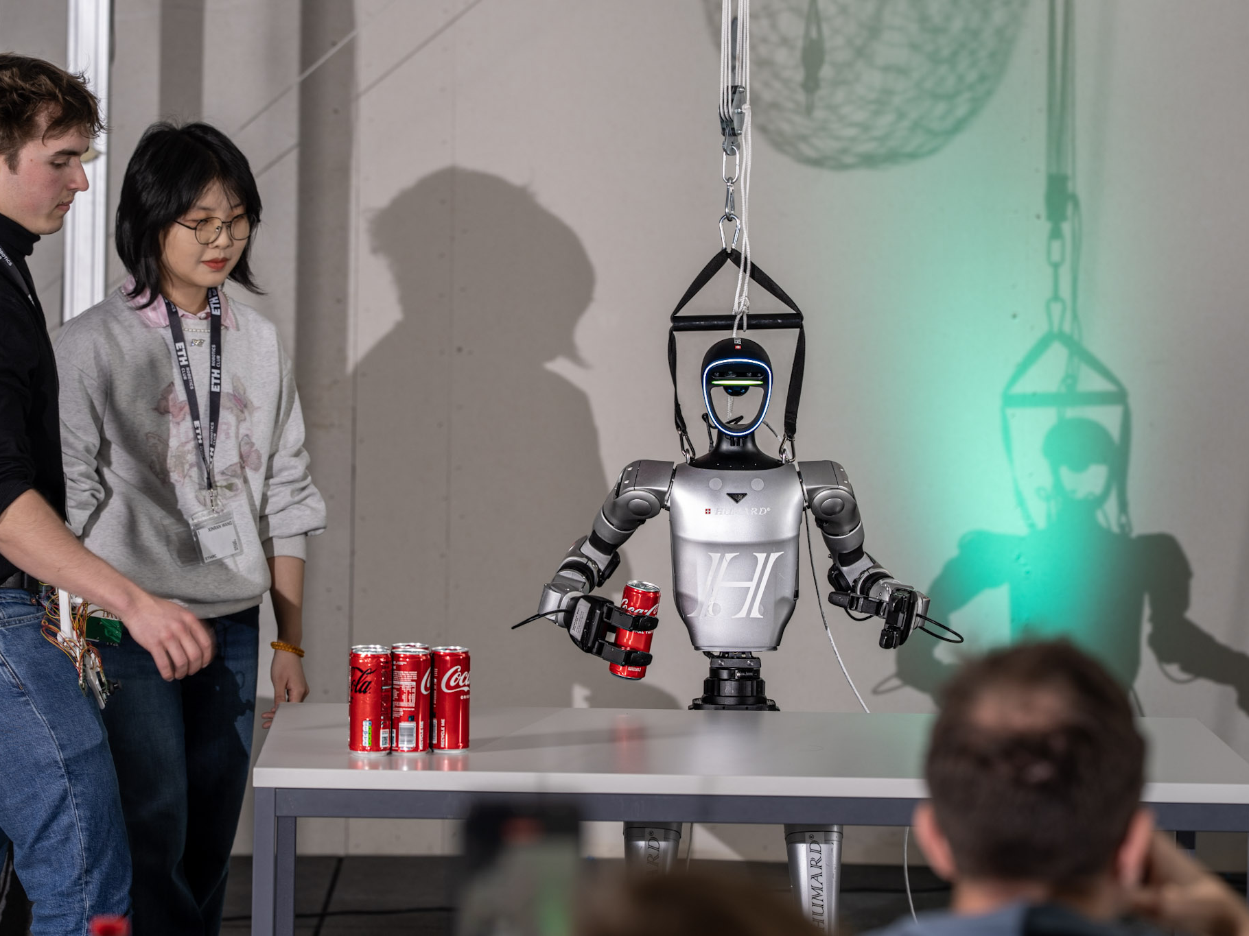
ROBOTICS CAPITAL
WHERE OUR RELATIONSHIPS BEGIN
06
Before a startup,
there is a team
trying to make
something work
350+ builders in the ETH Robotics Club.
We see the work, the team dynamics
and the response when a prototype
fails. That is where diligence begins.
That is where early conviction begins.
Sources: supplied ETHRC photograph and manager-reported membership. Community access is not exclusive. Each investment requires separate diligence and approval.
Notes:
PRESENTER SCRIPT
Before someone has a polished pitch deck, they have a problem they cannot stop thinking about. In the Hangar, we meet people at that stage. You learn a lot from watching a team work: who keeps going when the demo fails, who listens, who can turn an ambitious idea into something that works. Those observations do not replace diligence. They give us a better starting point for it. The club is where relationships begin. The fund is where we make an independent investment decision and take responsibility for helping a company progress.
SOURCES
User-supplied ETHRC community and GP roles. Supplied photograph DSC00178.jpeg. Swiss Deep Tech Report 2026, p. 13, profiles ETHRC as a robotics community initiative.
INVESTMENT CONTEXT
The photo shows an ETHRC demonstration, not a Theseus product or an identified founding GP group. No exclusive access, private pipeline count, university endorsement or automatic right to invest is claimed.
MEMBERSHIP CONTEXT
The 350+ member count is supplied by the manager for the ETH Robotics Club. It describes a community, not a guaranteed investment pipeline. Relationships are non-exclusive.

Slide 7
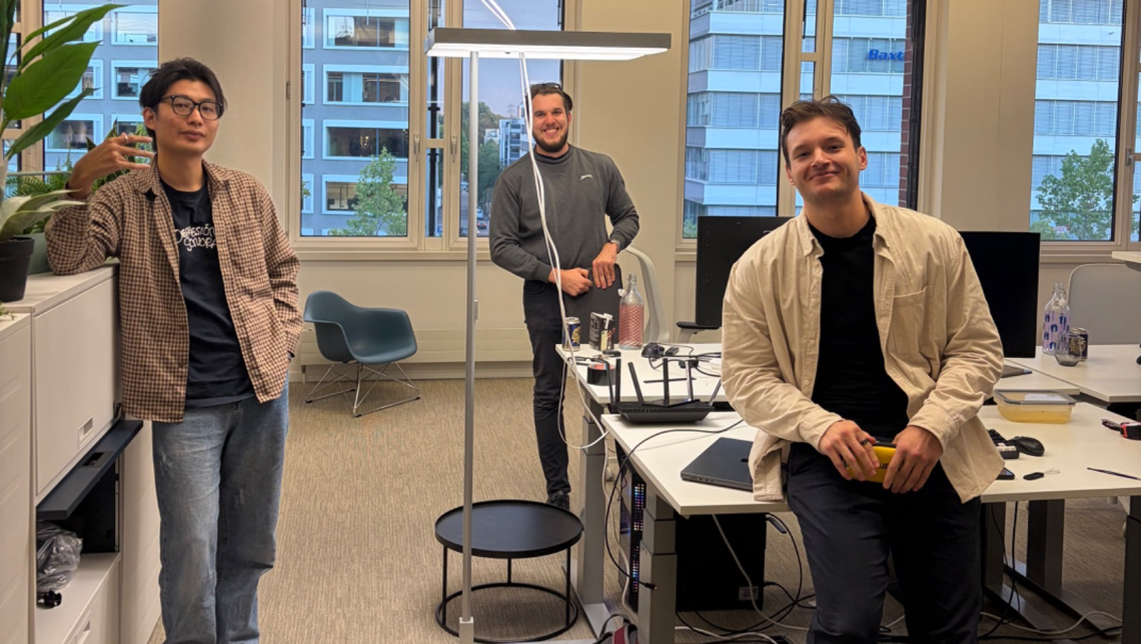
ROBOTICS CAPITAL
FIRST ROBOTICS CAPITAL INVESTMENT
07
Someone has to write
the first cheque
7
Theseus Robotics
DAYS
A team tackling grocery shelf restocking
with autonomous robots.
We invested. One week later,
they were accepted into Y Combinator.
Investment and seven-day chronology reported by the manager. YC acceptance is an external selection event, not a realized return or evidence of valuation uplift.
Notes:
PRESENTER SCRIPT
Theseus makes the strategy tangible. The team is working on autonomous grocery shelf restocking, a clear operational problem in a large, familiar industry. We wrote our first Robotics Capital cheque. One week later, they were accepted into Y Combinator, according to the chronology we have reported. We are proud to have backed them early. The real work now is turning that opportunity into a product customers want. That is the sort of company-building journey this fund is designed to support.
SOURCES
Manager-supplied Theseus investment and YC chronology. No public claim is based on the unrelated US defense company also called Theseus. The supplied mandate workbook’s separate CHF 32K Founderful Campus investment is not the Robotics Capital cheque.
INVESTMENT CONTEXT
The legal holder, executed instrument, settlement evidence, admission letter and batch should be available for diligence. The Robotics Capital investment precedes CHRF1 first close. Any allocation into the new fund remains subject to documented warehouse rules and approvals. No entry ownership or markup is asserted.

Slide 8
ROBOTICS CAPITAL
CAPITAL / COMPANY FORMATION
08
The first CHF 100K builds
the case for the next cheque
Fund the first proof. Invest further as the technical and customer evidence improves.
WHAT THE FIRST CHEQUE FINANCES
CHF 10M FUND ALLOCATION
Prototype | A working prototype, tested
Company & IP | Incorporation, IP and ownership
Customer proof | A buyer and credible economics
Seed readiness | A plan and budget for the seed round
ALLOCATION | CHF M
First cheques | 5.0
Follow-ons | 3.0
Lifetime fees¹ | 1.5
Expenses | 0.5
Total | 10.0
Approx. 50 first investments, with CHF 3M reserved for selected follow-ons.
Illustrative construction. ¹ CHF 1.5M lifetime fees assumes a declining base or step-down. Portfolio size, allocation and individual milestones remain subject to final terms and diligence.
Notes:
The first CHF 100,000 is designed to answer the questions that make a young robotics company financeable: does the technology work, does the company own its IP, is there credible customer demand, and is the next financing plan clear? We support incorporation, commercial preparation and relevant introductions alongside the capital. The working CHF 10 million fund construction allocates CHF 5 million to initial investments, CHF 3 million to selected follow-ons, CHF 1.5 million to lifetime fees and CHF 0.5 million to expenses. That supports approximately 50 first CHF 100,000 investments over roughly four years. The follow-on reserve lets us invest more after the technical and commercial evidence improves.
The first cheque is intended to finance technical and commercial validation, not a manufacturing facility. Milestones vary by company and pre-incorporation investments require appropriate legal and IP arrangements. The working case of 50 initial investments is illustrative. The supplied materials also contain a 25-company alternative, so final portfolio size remains open. CHF 1.5M lifetime fees requires a declining fee base or step-down; a flat 2% over ten years on CHF 10M would cost CHF 2M before expenses. Follow-on investments require independent diligence and approval.
Robotics Capital strategy and working fund construction: CHF 5M initial investments, CHF 3M follow-ons, CHF 1.5M lifetime fees and CHF 0.5M expenses, totalling CHF 10M. Initial ticket target CHF 100K.

Slide 9
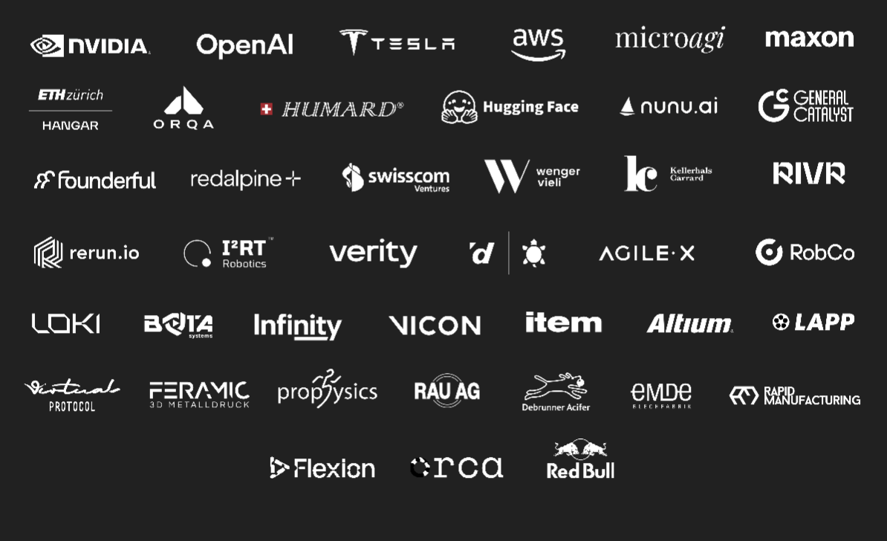
ROBOTICS CAPITAL
SWITZERLAND ROBOTICS FUND 1
09
A route from the first build
to the first institutional round
01
ETHRC HACK2027
We meet teams in the work.
02
START Global / Forge
Three winning teams fast-tracked.
03
Robotics Capital
Independent investment and
formation support along the way.
THE ETHRC ECOSYSTEM
2027 fast track: manager-reported. Logos show ETHRC relationships, not CHRF1 endorsements or guaranteed startup entitlements. ABB relationship separately manager-reported.
Notes:
PRESENTER SCRIPT
The next step is to make this pathway repeatable. The manager-reported HACK2027 partnership with START Global fast-tracks three winning teams into START Forge. We can get to know the teams, make independent investment decisions and support the work required to become ready for seed. Around that pathway is a real technology and industrial community. Our job is to turn relevant relationships into useful introductions, technical support and customer conversations for individual founders. Every entitlement still depends on the relevant agreement.
SOURCES
User-supplied HACK2027 partnership and three-team fast-track arrangement. Original ETHRC Partner List.png. Public programme: https://www.startglobal.org/start-forge. ABB relationship separately supplied by the manager.
INVESTMENT CONTEXT
The draft describes a three-month 2027 programme, while the current public START Forge page describes four weeks. Programme duration and contractual entitlements require reconciliation. The slide intentionally states no duration or exclusivity. ETHRC relationships do not automatically confer fund or portfolio access.

Slide 10
ROBOTICS CAPITAL
SWITZERLAND ROBOTICS FUND 1
10
We built the relationships
Now we are building the fund
Declan Shine
Erik Pfister
Mark Pfister
Chairman & CEO
COO / Managing Director
CFO / Managing Director
Close to the builders
Close to the market
Close to the numbers
Founder and President of ETHRC.
Early-stage investing through
Founderful Campus.
ETHRC VP and Head of Partnerships.
Founder, Heldings.
HSG Business Innovation.
Experience at EWOR, Ufenau
Capital Partners and InfoGuard.
Finance and operating execution.
Founder discovery and the
technical community.
Industry relationships and
commercial development.
Financial discipline, structuring
and investment operations.
Founding GPs of Robotics Capital AG. Sources: manager biographies, roboticscapital.ch and supplied investment schedule. Investment governance described in the notes is proposed.
Notes:
PRESENTER SCRIPT
There are three of us, with different jobs to do. Declan is closest to the technical community and the teams emerging from it. Erik connects that community to industry and commercial opportunities. Mark brings financial and operational discipline to the investment process. We have built relationships that make this strategy possible, and we know proximity alone is not enough. For CHRF1, our proposed process pairs technical and customer diligence with written investment decisions, conflict management and consistent LP reporting.
SOURCES
https://roboticscapital.ch. Manager-supplied biographies and current founder roles. Draft_01.pdf, team section. Supplied investment schedule, Founderful Campus cohort.
INVESTMENT CONTEXT
The draft’s unnamed venture partner, independent IC appointments and four-year presidency commitment are not treated as completed appointments or signed commitments. Proposed controls: technical expert input, customer evidence, legal/IP review, written IC approval, conflict recusals and documented allocations. Named advisors should be shown only once appointed. No claim of previous full-cycle robotics company scaling by all founding GPs.

Slide 11
ROBOTICS CAPITAL
PRIOR INVESTMENT EXPERIENCE
11
Our experience includes
capital returned
CHF 2.20M
realized proceeds
20% manager-reported IRR
Erik & Mark’s discretionary mandate
11 investments / 2017 to 2025 vintages
CHF 7.59M remaining value
CHF 4.81M invested
Invincible Brands
Deel
Moving Intelligence
3.98x
4.90x
3.04x
CHF figures: earlier supplied schedule. IRR: manager update, 2 Oct 2026; valuation date and gross/net basis unverified. Includes unrealized value. Not CHRF1 performance.
Notes:
PRESENTER SCRIPT
Our discretionary mandate has a manager-reported IRR of 20%, based on the current portfolio valuation. That experience includes both capital returned and value still held. The earlier schedule shown alongside it records CHF 4.81 million invested, CHF 2.20 million realized and CHF 7.59 million remaining. Those figures are a historical snapshot and are not the valuation inputs behind the updated IRR. Our prior mandate experience remains separate from CHRF1. We bring that experience to a new fund focused on founders at the beginning of their journey.
SOURCES
IRR: Erik Pfister, manager update in this conversation on 2 October 2026, stating that the current portfolio market value creates a 20% IRR and that the supplied spreadsheet is not updated. Earlier CHF figures and selected multiples: supplied Robotics Capital Pre-Raise Discretionary Mandate Portfolio.xlsx, Sheet1, rows 6 to 16.
INVESTMENT CONTEXT
20% IRR is manager-reported, based on current portfolio value including unrealized holdings. The cash-flow calculation, gross/net basis and precise valuation measurement date were not supplied. 2 October 2026 is the date of the manager update, not an independently established valuation date. The IRR has not been independently calculated or verified. The older schedule records cost CHF 4,807,892, realized CHF 2,199,354 and remaining value CHF 7,592,961, yielding 2.0367169x value/cost. It is an earlier snapshot and cannot reconcile the updated IRR. The selected company multiples and full 11-position table also refer to that earlier schedule. Prior discretionary mandate results are not CHRF1 performance. Mandate vintages do not imply personal selection by each GP throughout that period.
INVESTOR REVIEW
The main figure now leads with realized proceeds in the supplied historical schedule. The 20% IRR remains explicitly manager-reported and separate. Before investor circulation, obtain dated cash flows, the valuation policy and measurement date, and a clear gross/net and fee basis. Do not claim a benchmark ranking or that historical results are CHRF1 performance.

Slide 12
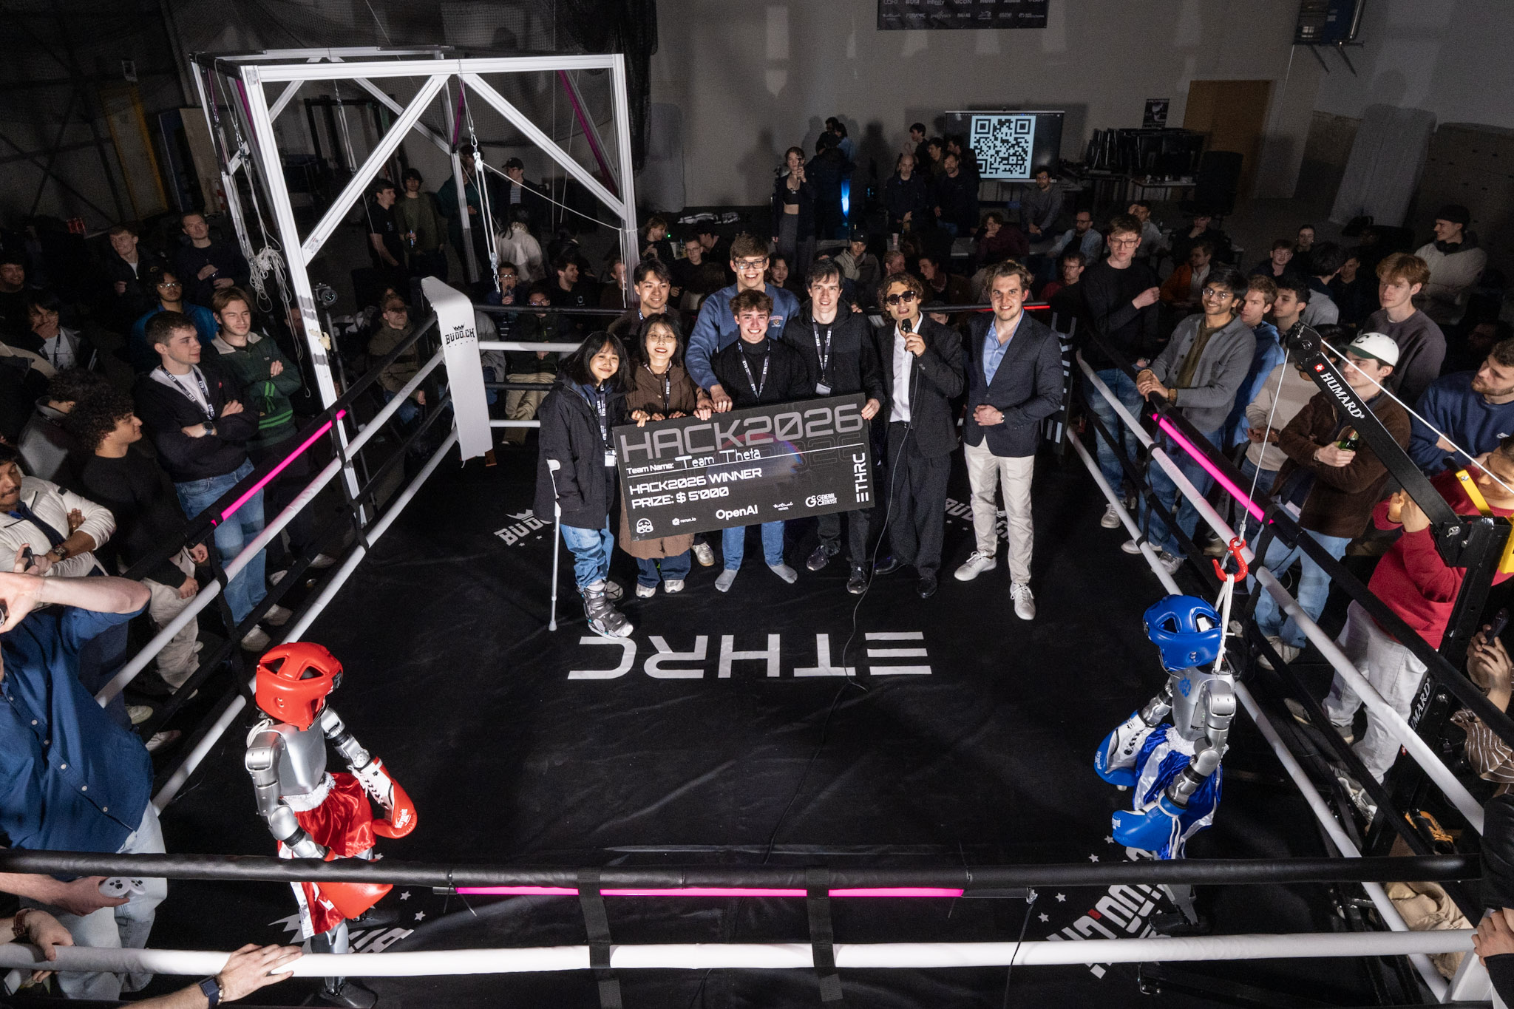
ROBOTICS CAPITAL
TARGET FIRST CLOSE / Q4 2026
12
We can build
this future here
The next generation is already getting to work.
We invite you to help write its first cheque.
Target fund | CHF 10M
Minimum direct LP | CHF 250K
Fund / investment period | 10 years / ~4 years
Management fee / carry | 2% / 20%
GP commitment / pref. | CHF 100K / 8% if final LPA
Meet the founders.
Review the fund.
Join the first close.
roboticscapital.ch
Indicative; final terms subject to counsel, LPA, tax and regulatory review. Fee base and optional preferred return subject to final terms.
Notes:
PRESENTER SCRIPT
What gives us confidence is the people. We can see the effort, the ingenuity and the ambition already here. We want more of that to become companies with customers, products and lasting value. Europe’s industrial future will depend in part on the founders who choose to build it. Switzerland has an opportunity to help lead. We are raising CHF 10 million, with a target first close in Q4 2026 and a CHF 250,000 minimum direct commitment. We invite you to meet the team, review the fund with us and become one of its first investors.
SOURCES
Manager-supplied fund terms. Supplied HACK2026 awards photograph DSC00230.jpeg. https://roboticscapital.ch.
INVESTMENT CONTEXT
Target investors: Swiss family offices, corporate strategics, ETH/HSG alumni, angels through a pooled feeder and patient mission-aligned capital. A feeder is subject to its own legal, tax and operational structure. GP commitment CHF 100K assumed included in target commitments. 8% preferred return applies only if included in the final LPA. No urgency based on invented allocations or deadline scarcity.

